Slide 1
Project Management App
Reem Essam

Slide 2
Description :
The main functions of this app is viewing and managing user tasks with statues.
It contains 4 screens (Sign In – Sign Up – Main Screen – Add & Edit Screen).
Additional libraries:
Floor library to cache the data into the internal storage.
Firebase Authentication to manage sign up & sign in functions.
Shared Preference to Keep the user signing in until the user press logout.
Note: Stored data is not related to user id (Data is shared with all users).

Slide 3
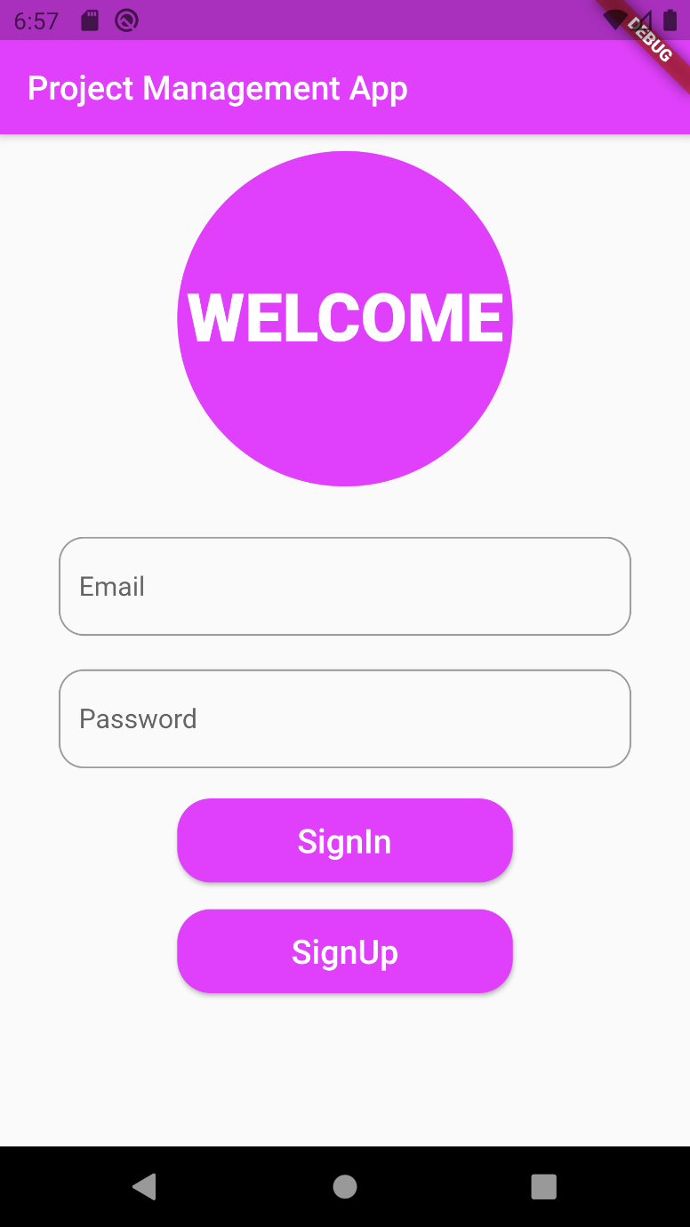
1- Sign In Screen:
This page uses
Form Widget : To manage user inputs.
Firebase Authentication to perform sign in function

Slide 4
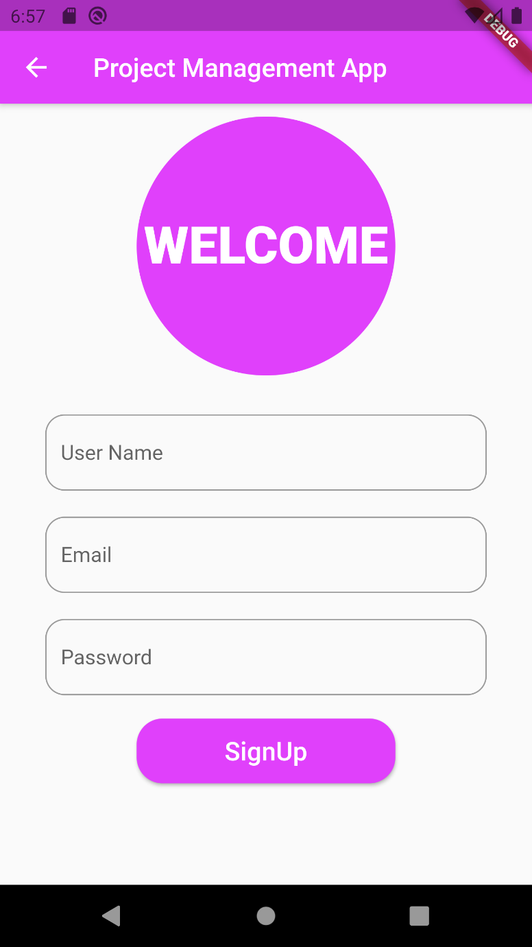
2- Sign up Screen:
This page uses
Form Widget : To manage user inputs.
Firebase Authentication to perform sign up function

Slide 5
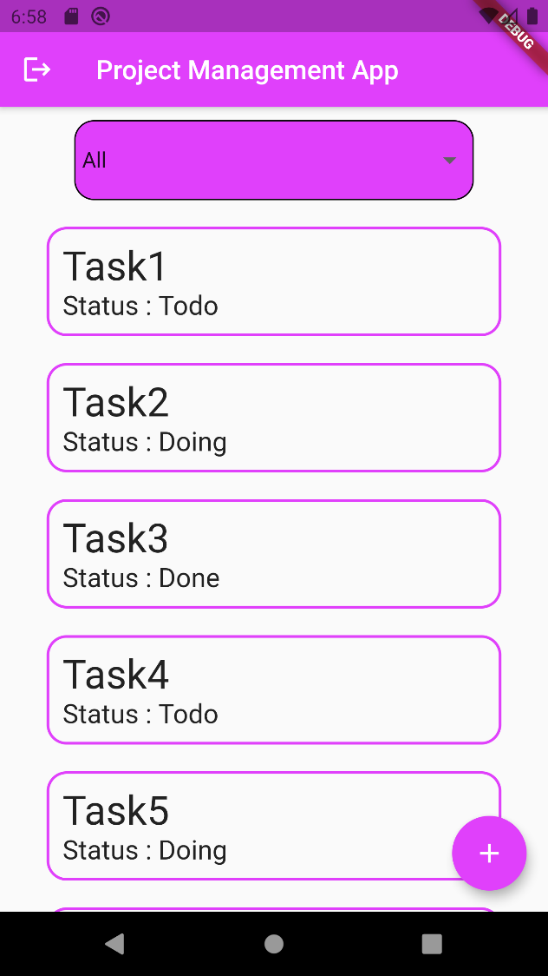
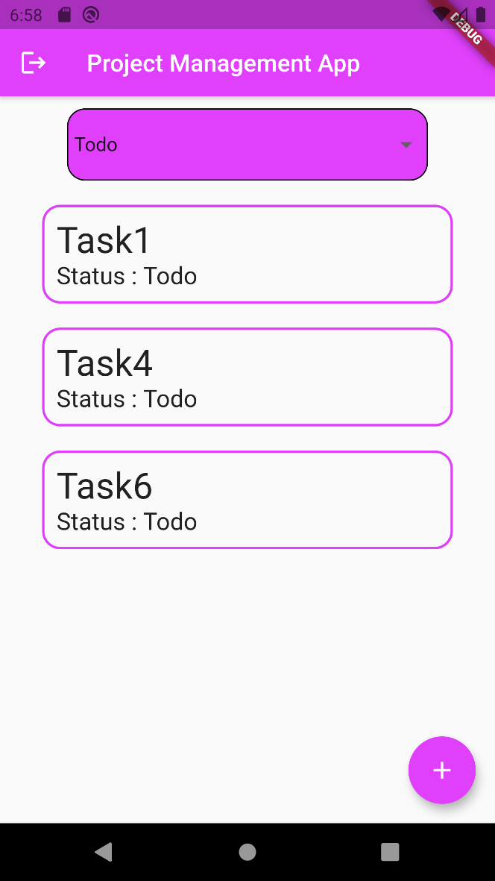
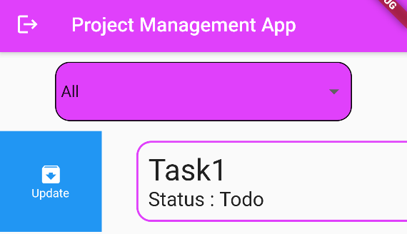
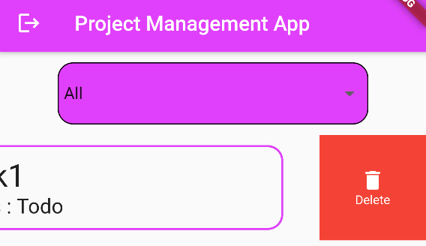
3- Main Screen :
This page uses
Drop Down Button : to filter tasks based on their status
Dynamic List View: to view the Tasks
Floating Button : to add new task
Slidable : around the list view item which support two options (Add – Delete)

Slide 6
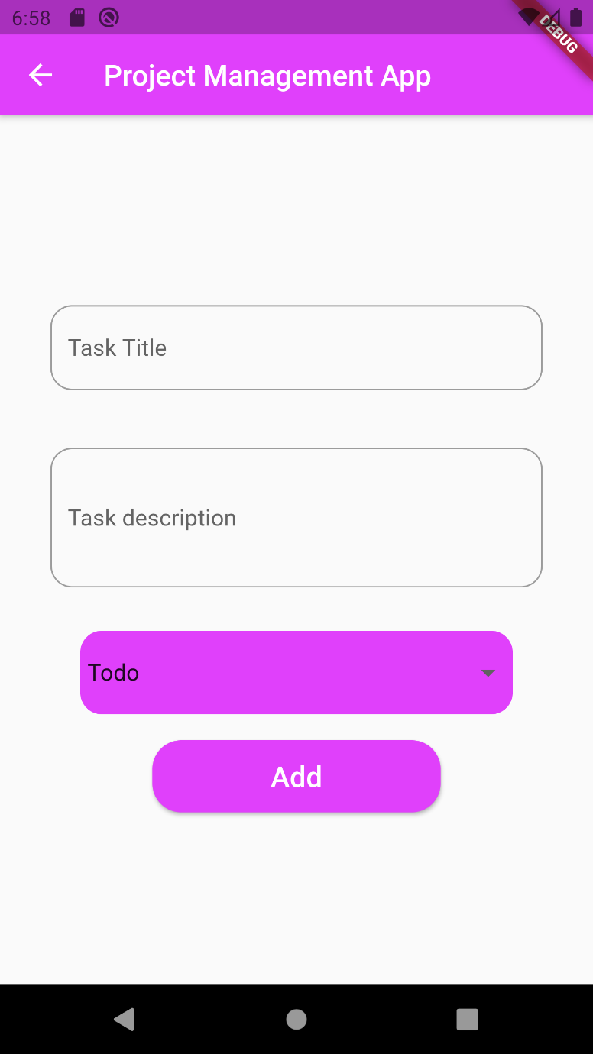
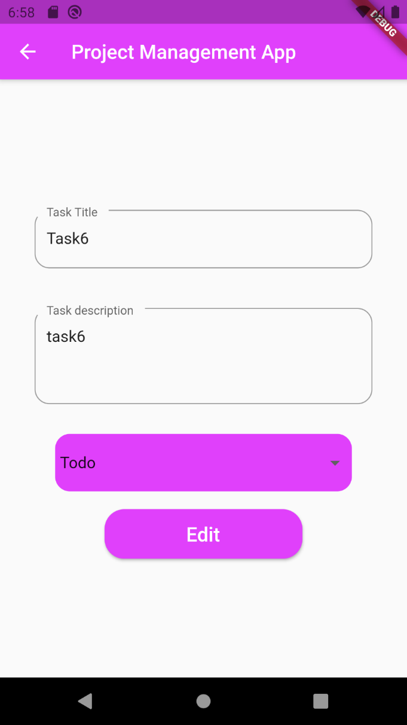
4- Add & Edit Screen:
This page uses
Two Text fields and drop down button : to add and edit tasks
Uses floor library to add tasks to database and edit it

Slide 7
Project Link on Gitlab:
ReemEssam25 / Project Management App · GitLab

